Slide 1
Introduction to Metagenome Binning MGM23-JGI Sep 2016
David Páez-Espino, PhD.
adpaezespino@lbl.gov
@DaviPaez

Slide 2
Outline
Binning. Why?
Methods
MetaBAT (Metagenome Binning with Abundance and Tetra-nucleotide frequence)
ESOM (Emergent Self Organizing Maps)
Exercise:
Analysis of a “Marine sediment microbial communities from the Hellenic Volcanic Arc”

Slide 3
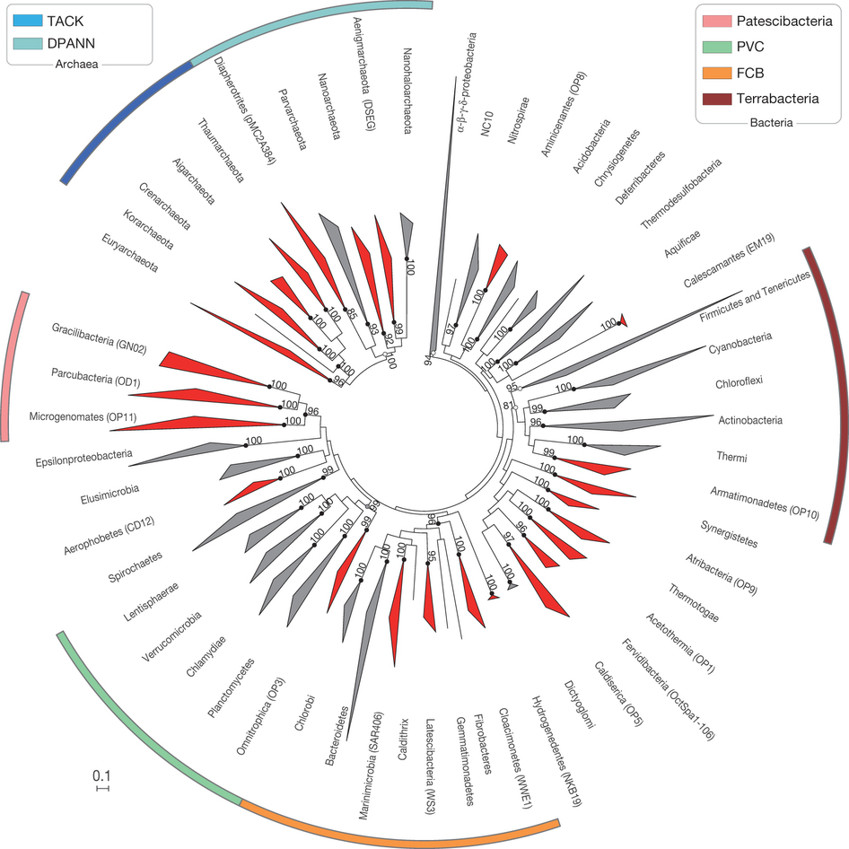
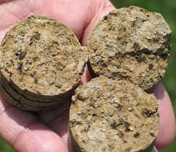
Why binning metagenomes?
who’s there?
Rinke et al, 2013

Slide 4
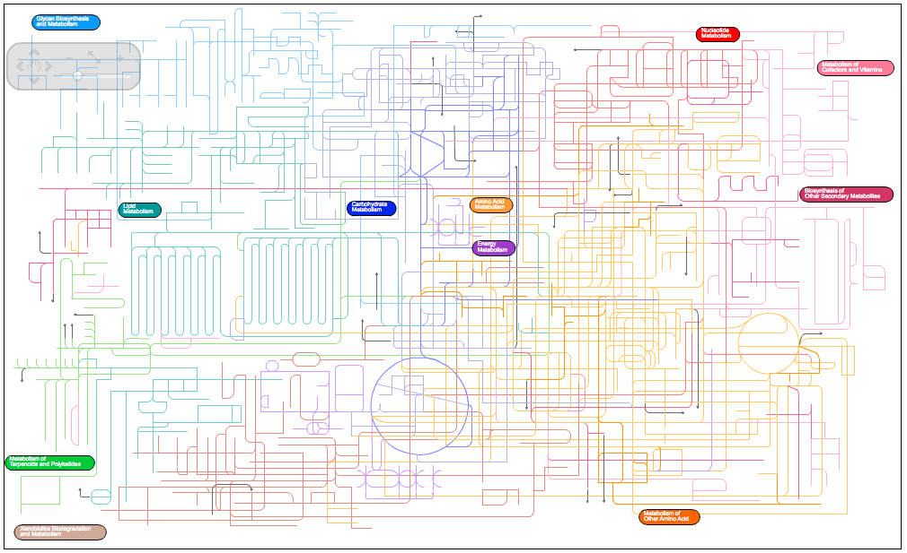

Why binning metagenomes?
what are they doing?
pathways.embl.de/iPath2.cgi
Notes:
Metabolic potential

Slide 5
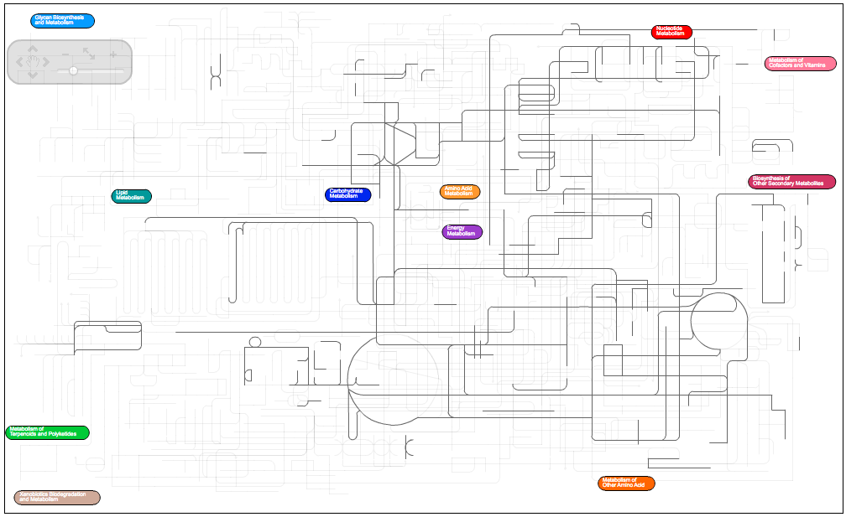
Why binning metagenomes?
GOAL: who’s doing what ?
Methanocaldococcus jannaschii DSM 2661
pathways.embl.de/iPath2.cgi

Slide 6
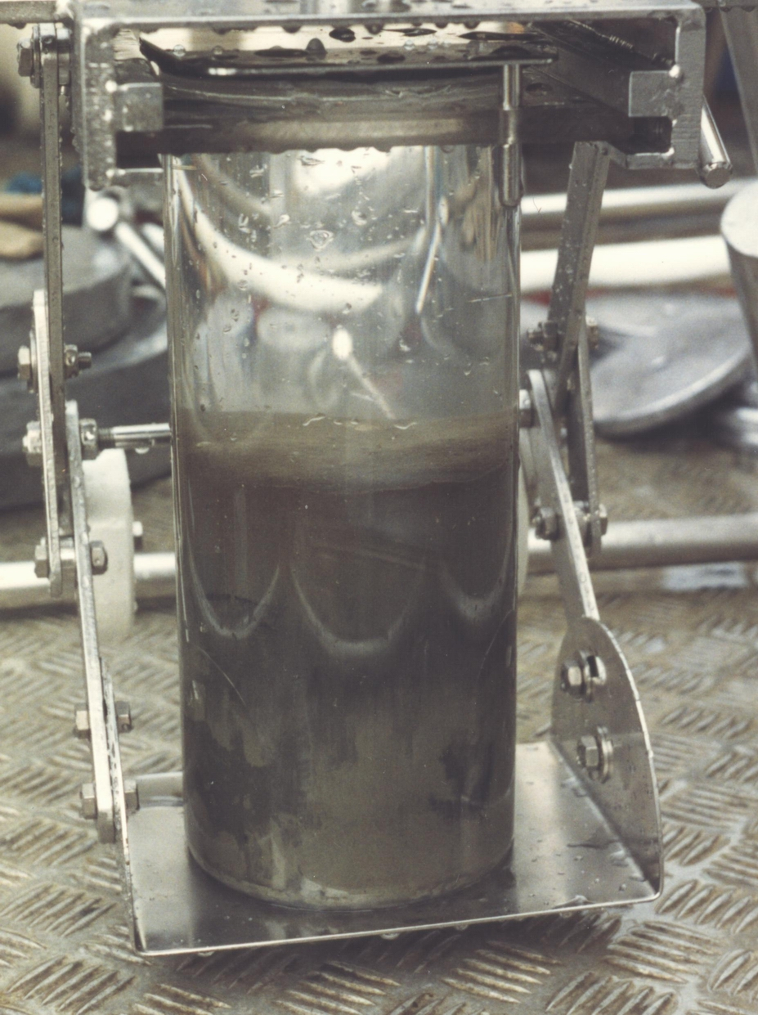

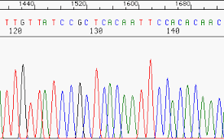
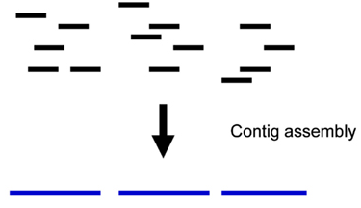
Why binning metagenomes?
How can we get that GOAL?
IMG/MER
pipeline
sample
DNA extraction
Sequencing
Assembly
?
Which contigs belong together?

Slide 7
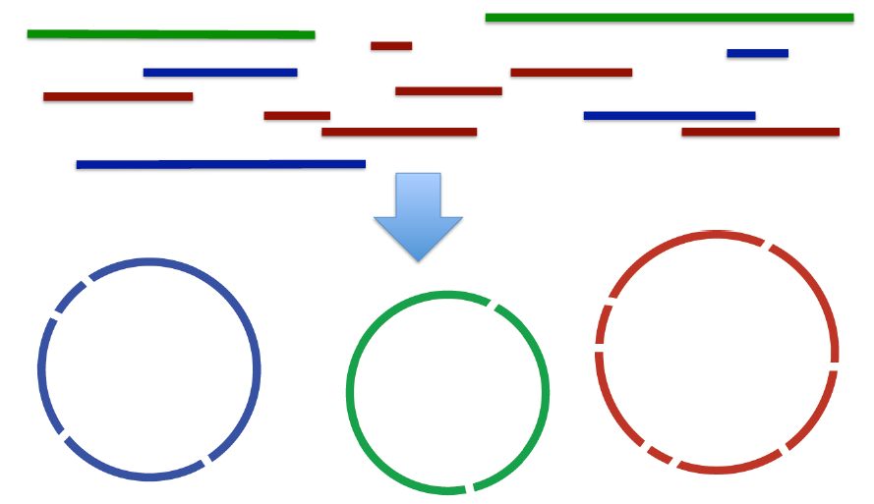
Metagenomic binning goal
Group contigs from a source organism with minimal contamination

Slide 8
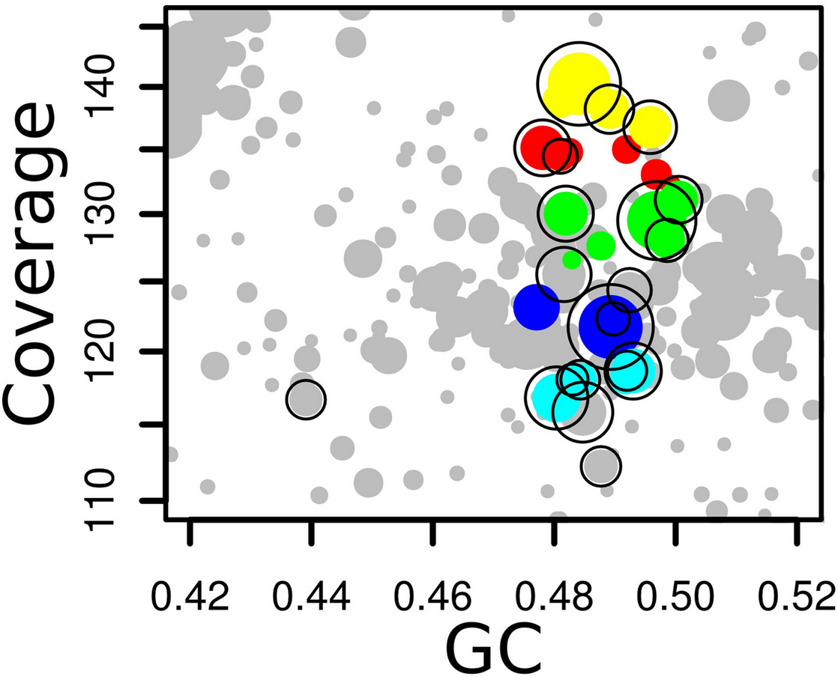
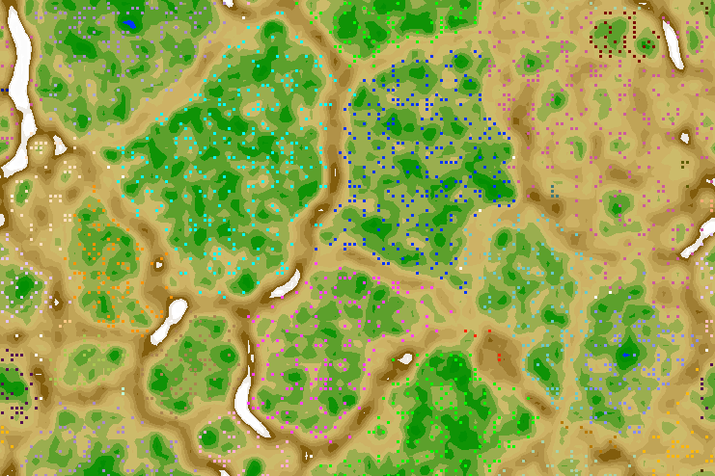
Binning Techniques
Coverage
Sequence composition (GC%, tri-, tetra- …)
Phylogeny (sequence similarity)
Abundance pattern
Combinations are BEST
E.g. ClaMS, MaxBin, TETRA, Phylopathia, MEGAN, CARMA, Phymm, ABAWACA, VizBin, Canopy, CONCOCT …
MetaBAT
ESOM
Oulas et al. Env. Micro (2016) “Metagenomic investigation of the geologically unique Hellenic Volcanic Arc reveals a distinctive ecosystem with unexpected physiology” (THURSDAY 9am talk, Rekha )

Slide 9

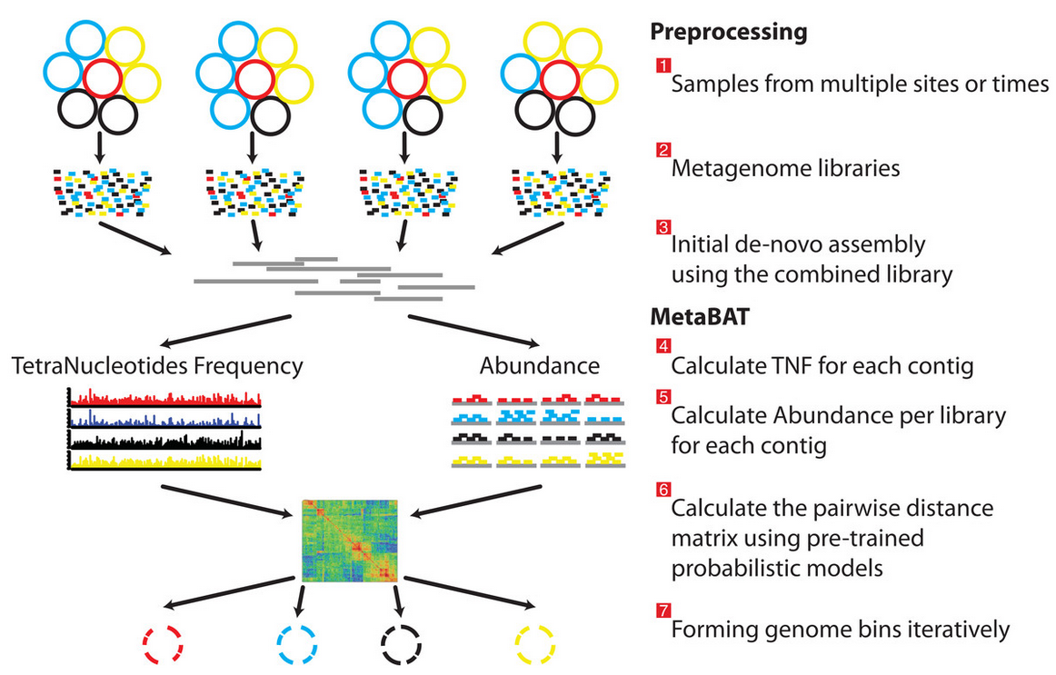
MetaBAT binning
Metagenome Binning with Abundance and Tetra-nucleotide frequence.
Probabilistic (Euclidean) model of TNF and Abundance distances.
JGI developed tool
http://www.readcube.com/articles/10.7717/peerj.1165

Slide 10
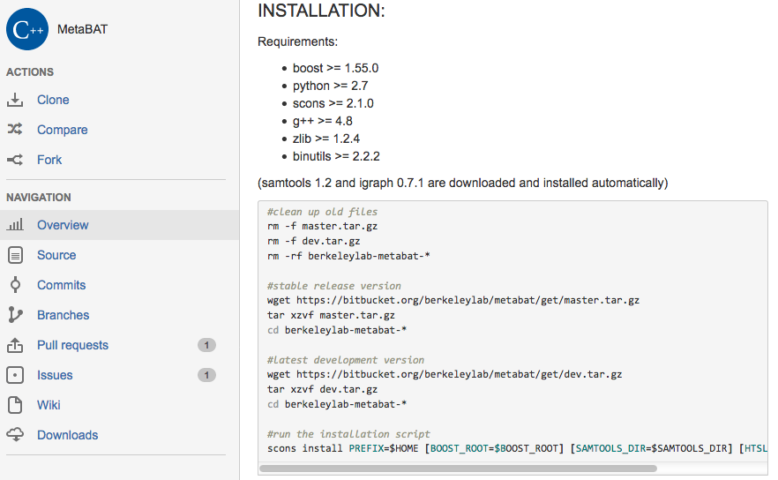
MetaBAT binning
https://bitbucket.org/berkeleylab/metabat/overview

Slide 11
MetaBAT binning. Workflow
Preparation
- Contig FASTA files to be binned (assembled)
- Optional coverage (Bam file)
-- from IMG
(2) Run MetaBAT (command line)
(3) Interpret results
(cross ref with IMG annotations)
(4) Additional (coverage info, R packages …)

Slide 12
Pipeline MetaBAT:
Install MetaBAT
https://bitbucket.org/berkeleylab/metabat/overview
Get all the >50 kb contigs from metagenome 3300002231 (fasta file)
IMG/M
Run MetaBAT:
metabat –i <input.fa> -o <outputs.fa>
metabat -i <assembly.fa> -a depth.txt –o <output>
runMetaBat.sh <flags> assembly.fa *.bam (see details in “help”; metabat -h)
Interpret results (import scaffolds into IMG -annotations)

Slide 13
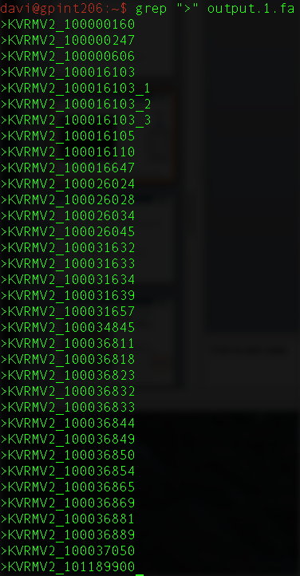
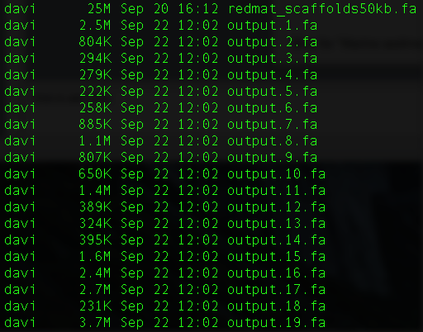
Exercise output (MetaBAT)
BINS
Aminicenantes
Candidate division OP8 bacterium
(CO₂ fixation)
Phylogenetic
references
annotations
Metabolic
capabilities
Bins for “Marine sediment microbial communities from the Hellenic Volcanic Arc”

Slide 14

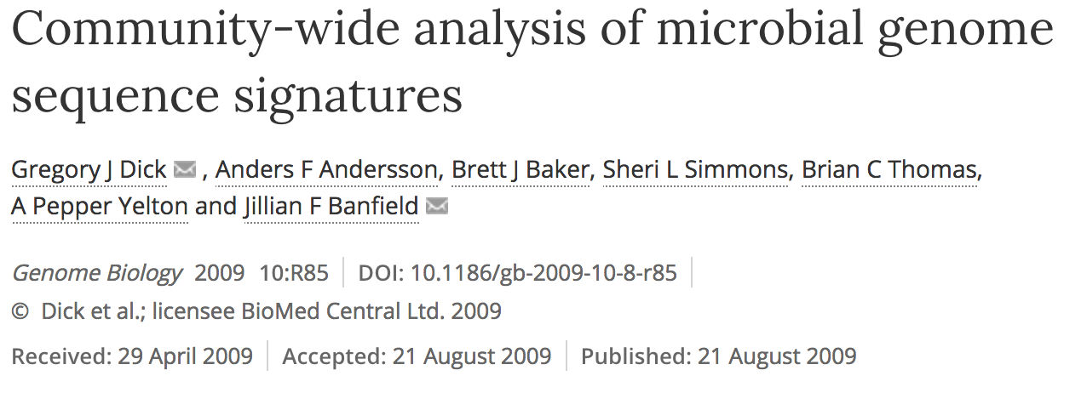
ESOM binning
First described
Best described
https://github.com/tetramerFreqs/Binning

Slide 15
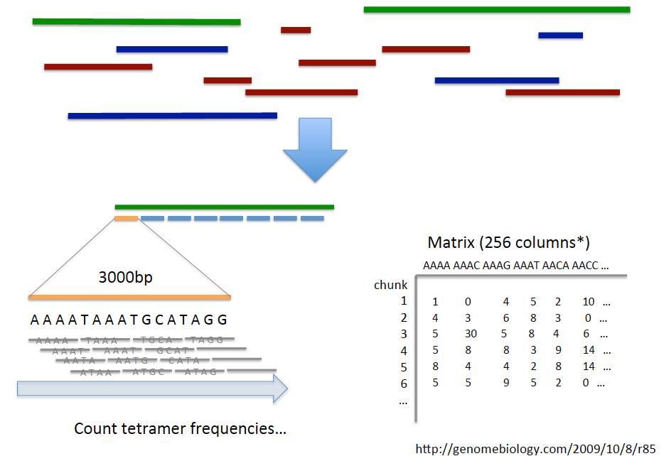
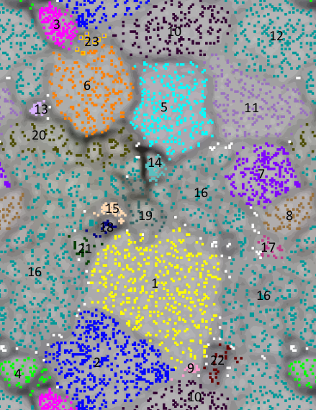
ESOM binning
Scaffold_A
Scaffold_B
Scaffold_C

Slide 16
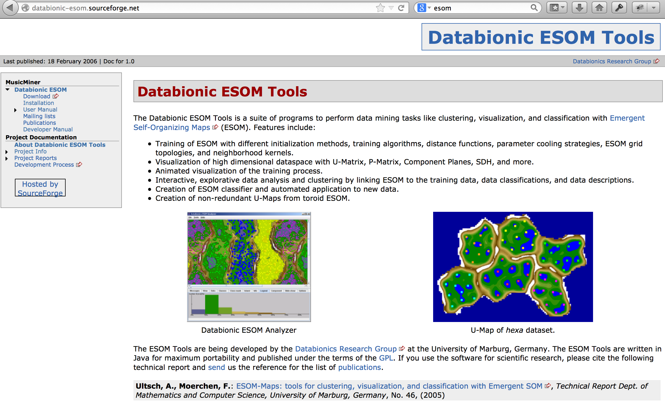
ESOM binning
http://databionic-esom.sourceforge.net/

Slide 17
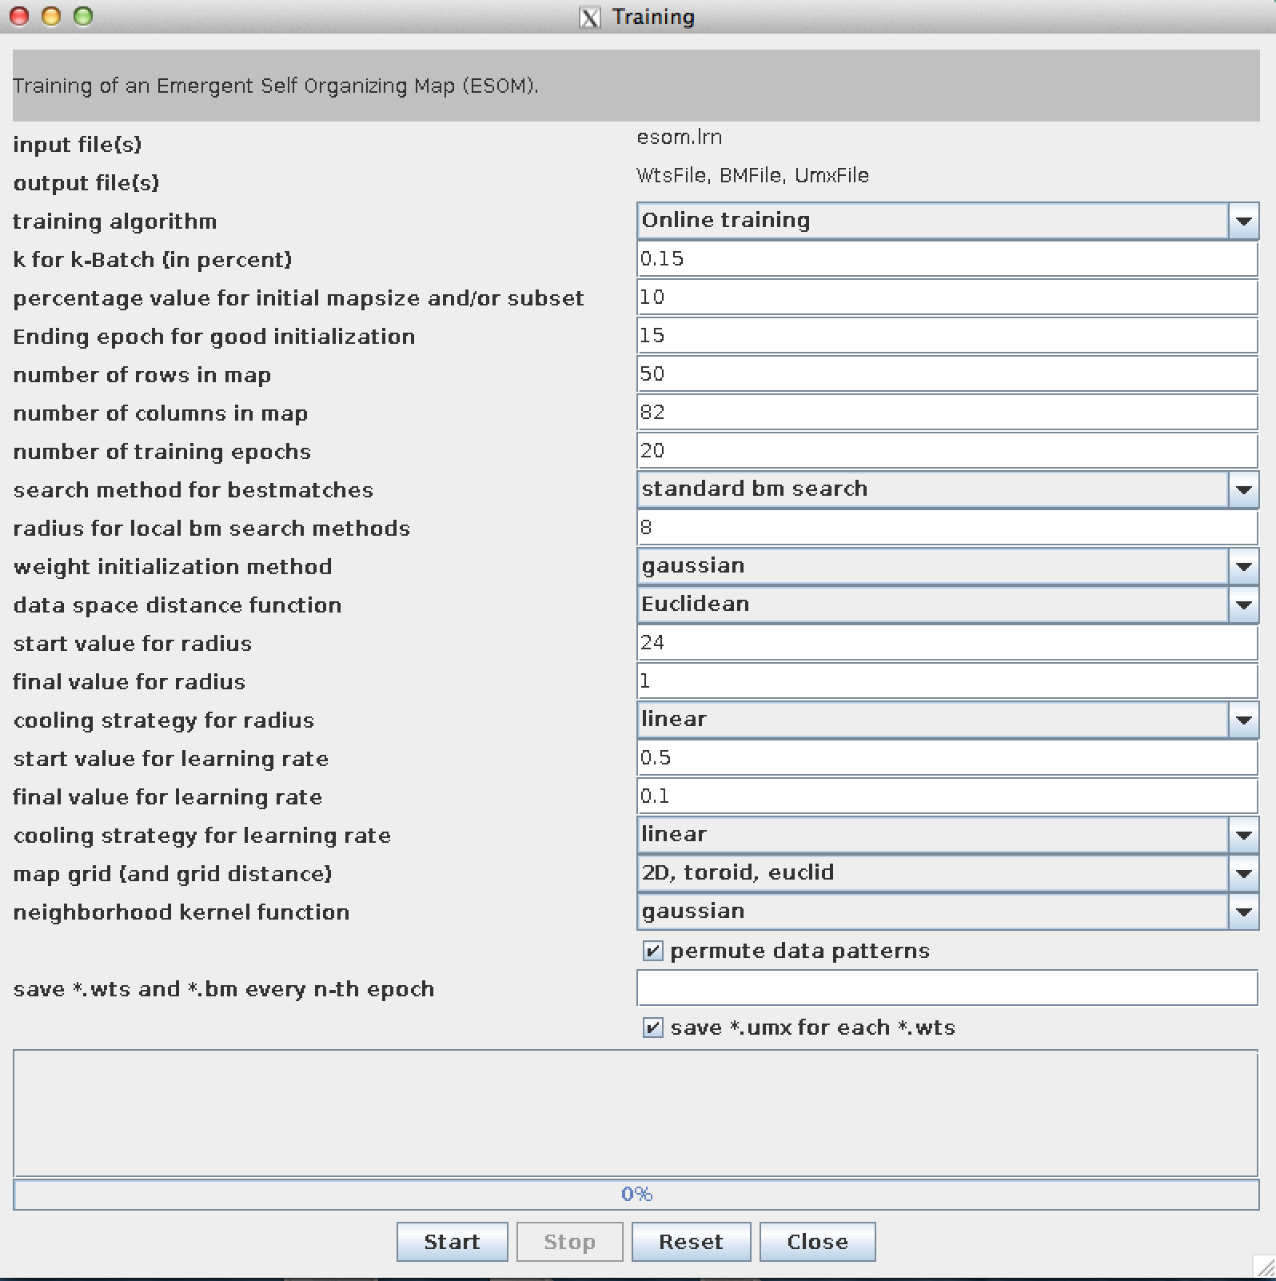
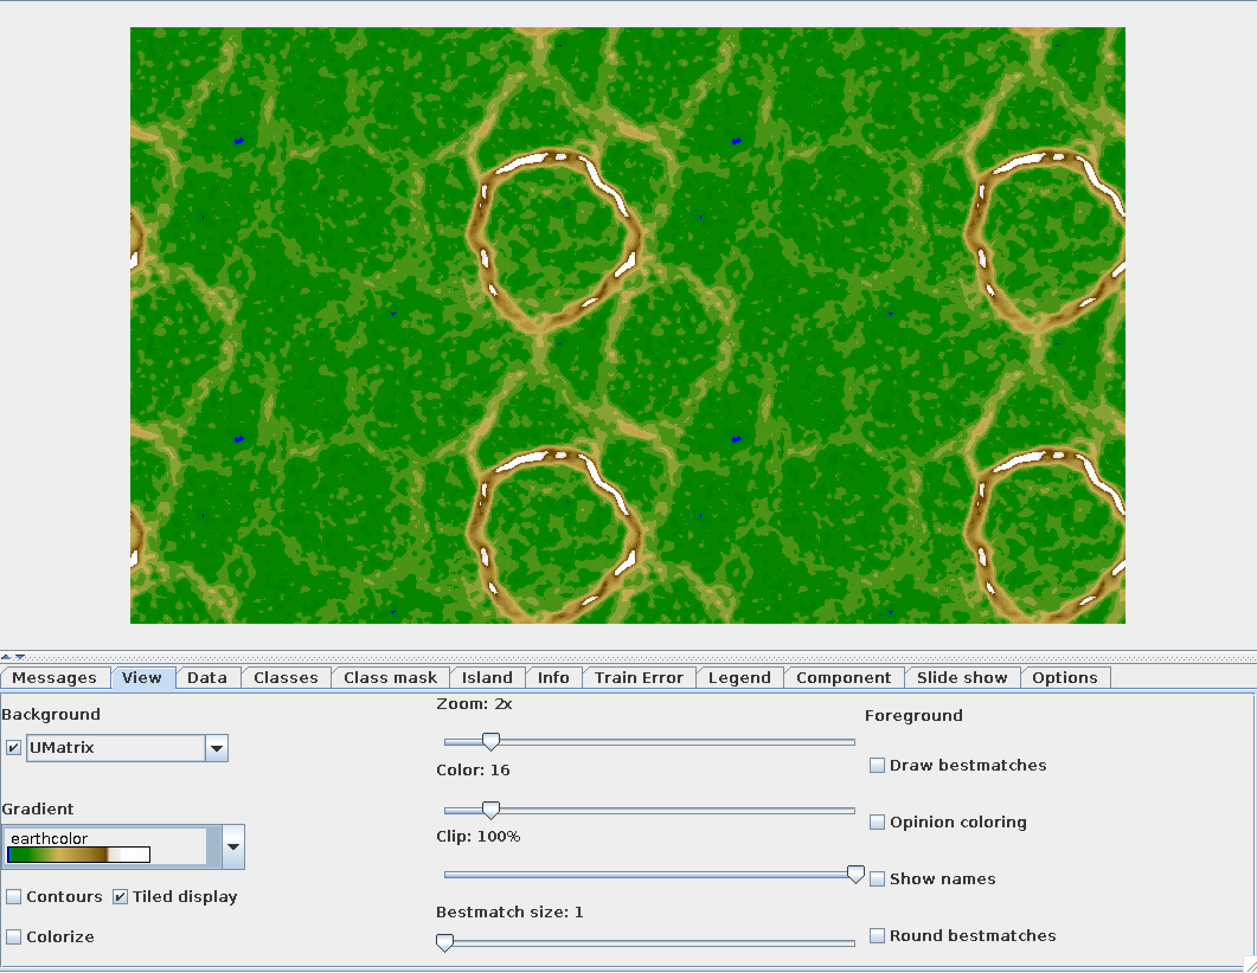
ESOM binning. Workflow
Preparation
- Contig FASTA files to be binned
- It requires specific format of input files: *.lrn, *.names, *.cls
**(perl script attached in the Agenda –courtersy © of Dr. Itai Sharon)**
(2) Run ESOM (UI / command line)
(3) Visualize / interpret Map

Slide 18
Pipeline ESOM:
Install ESOM
http://databionic-esom.sourceforge.net/
Get all the >50 kb contigs from metagenome 3300002231 (fasta file)
IMG/M
Prepare esom files:
perl prepare_esom_files.pl <flags> <output> <input.fa>
** flags –w (windows size) –k (k-mer) --coverage
perl prepare_esom_files.pl –w 10000 <output> <input.fa>
Open (ESOMANA) / run ESOM
Visualize / interpret the Map (import scaffolds into IMG -annotations)

Slide 19
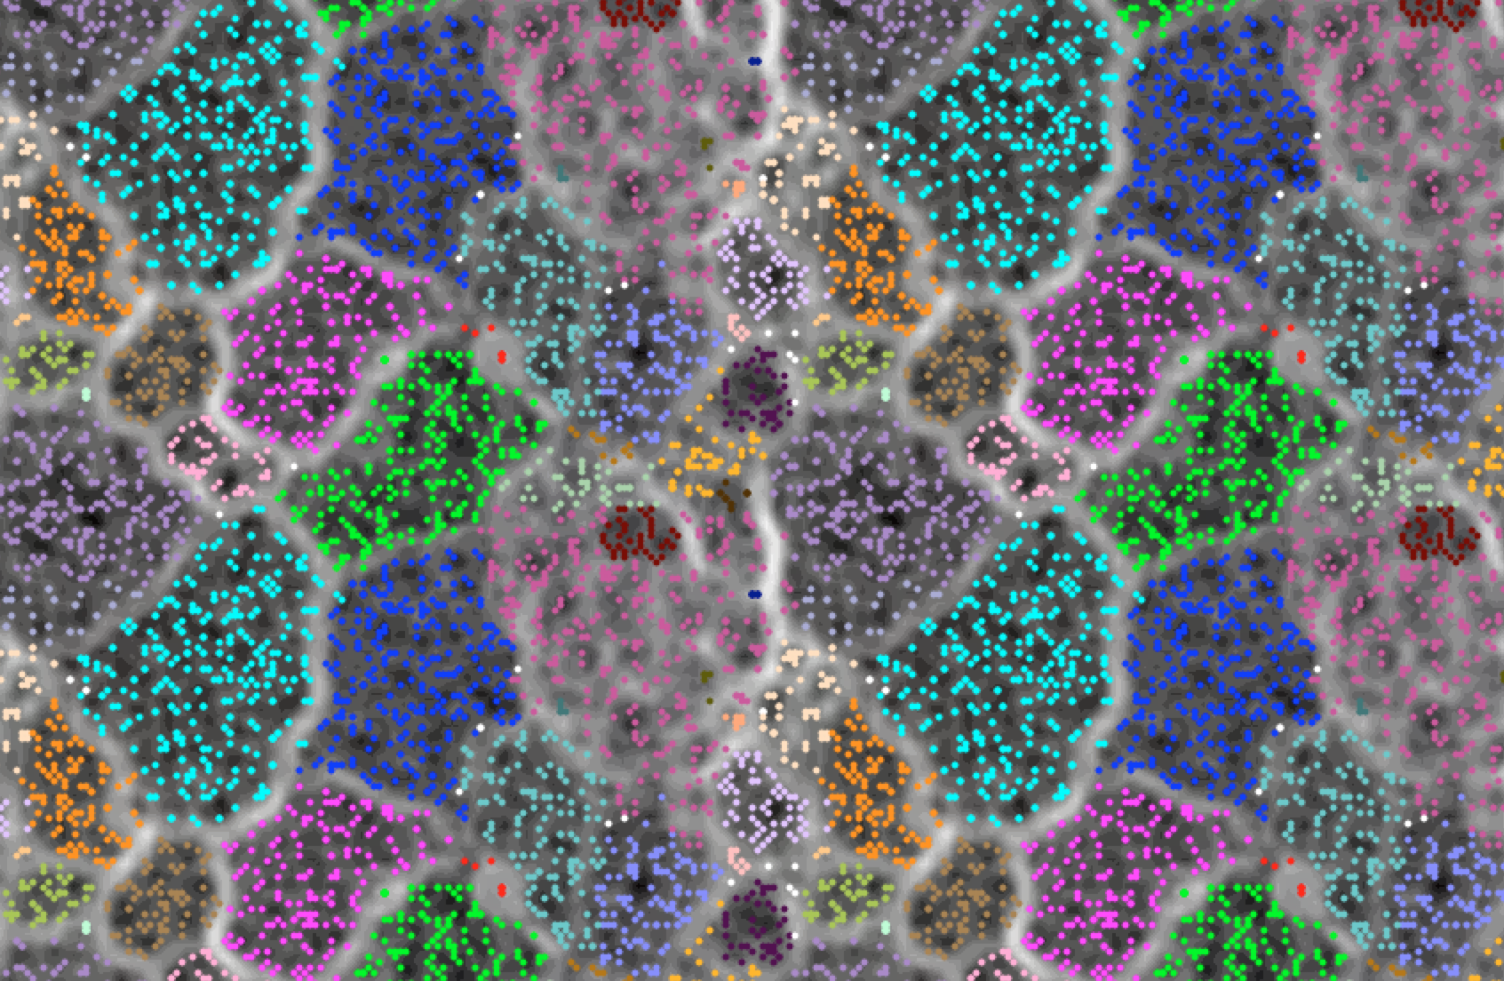
Exercise output (ESOM)
BINS
Aminicenantes
Candidate division OP8 bacterium
(CO₂ fixation)
Phylogenetic
references
annotations
Metabolic
capabilities
Bins for “Marine sediment microbial communities from the Hellenic Volcanic Arc”

Slide 20
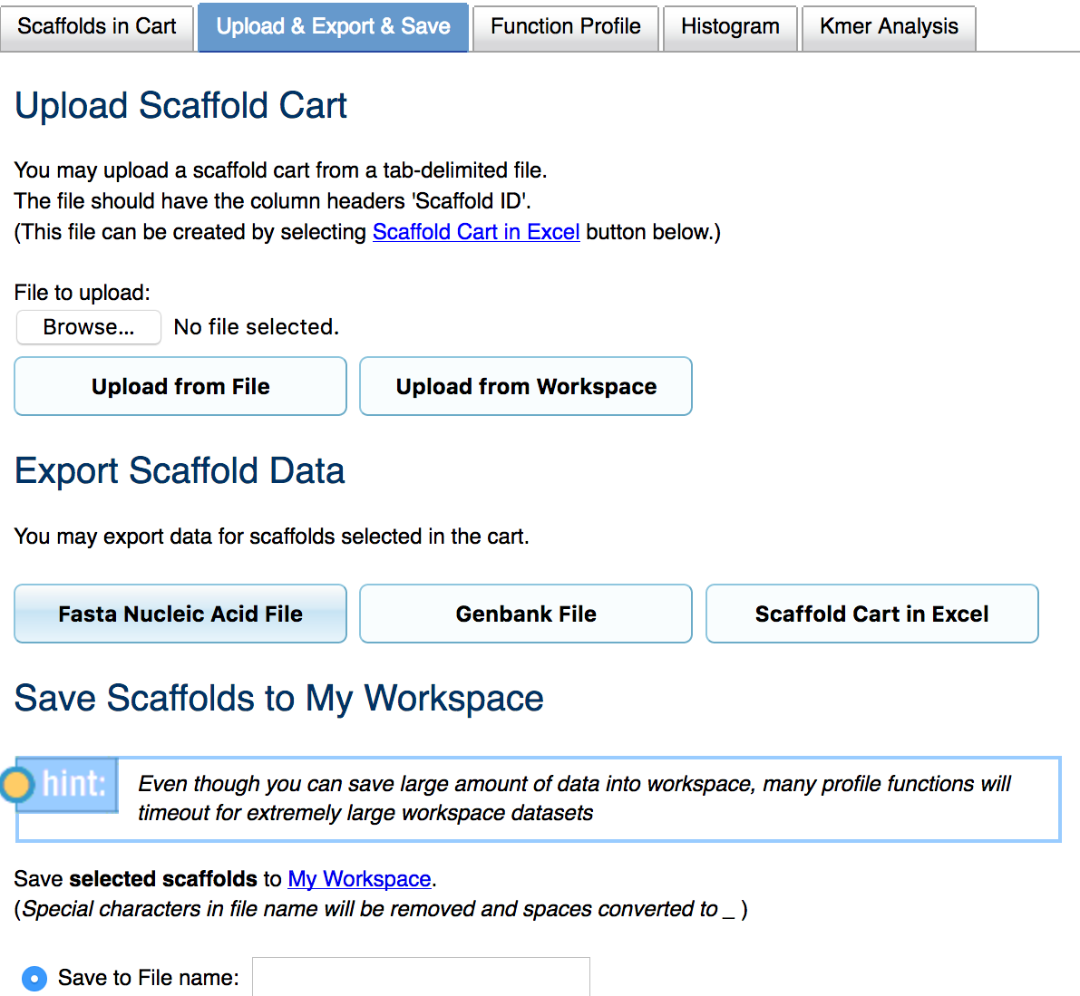
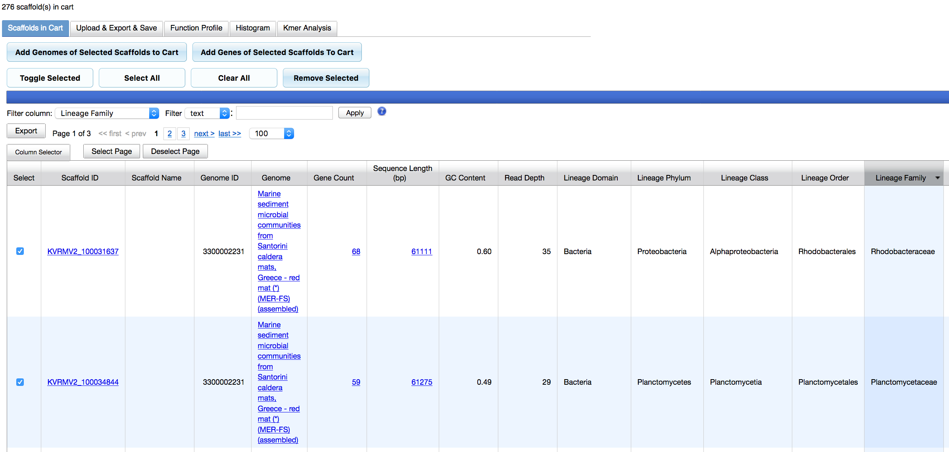
Scaffolds from/to IMG/M
Get all the >50 kb contigs from metagenome 3300002231 (fasta file) IMG/M
Quick genome search:
Scaffold Search
Sequence Length
>50,000
Add to scaffold cart
Upload & Export & Save
Taxonomy / lineage

Slide 21
MetaBAT vs ESOM (based on example)
Complementary tools!!
Comparable results (consistent bins)
 | MetaBAT | ESOM
Speed | great | poor
Accept Coverage | Yes | Yes
Preparation of Inputs | No | Yes
method | Automated | Semi-automated
UI / Command line | Command | UI and Command
visualization | poor | great
Machine type | All | Mac
# of bins | 19* | 21*
# of contigs | 221 (out of 276) | 276
*viruses

